Slide 1
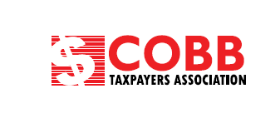

Slide 2
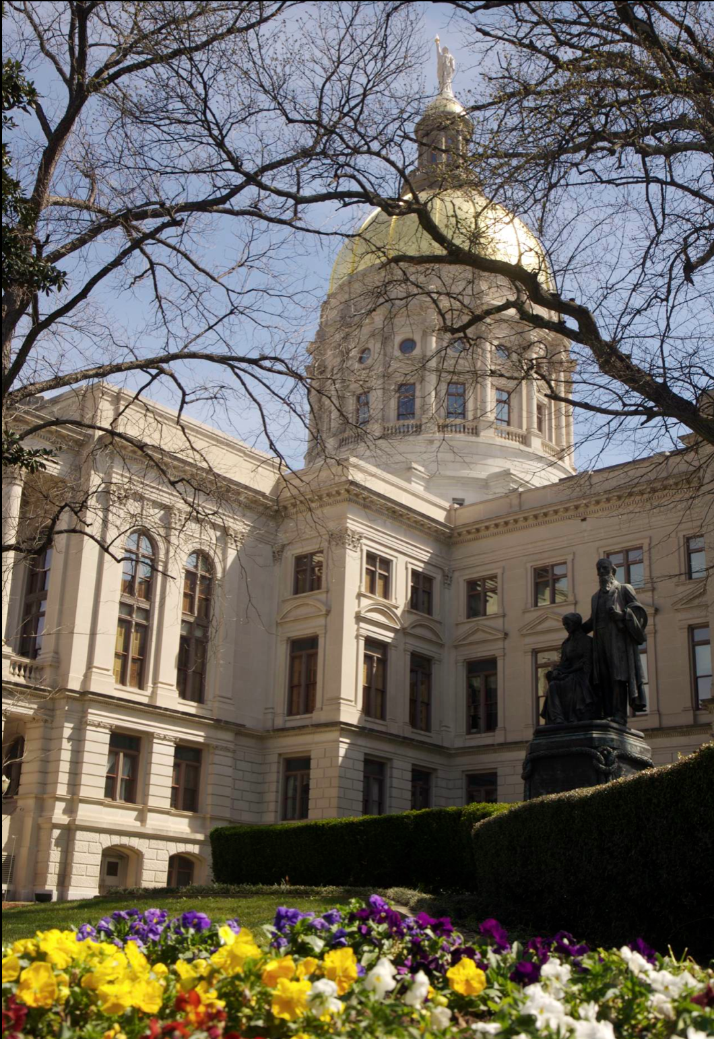
Special Purpose Local
Option Sales Tax
(SPLOST)
Notes:
All of us will have to assess whether the legislature’s effort, the SPLOST, is in the best interests of our family, community, businesses, county, region, and state. Get past the emotions and ask:
- What are the goals?
- How much are we willing to spend on them?
- What is the most efficient way to accomplish them?
Responses will then answer “What are we getting out of it?” as well as, “What are we getting into?”

Slide 3
All that is necessary for the triumph of evil
is that good men do nothing.
Edmund Burke

Slide 4
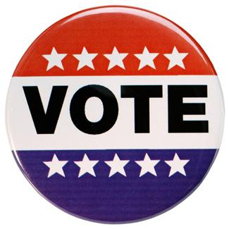
Why Vote NO to the SPLOST?

Slide 5
The Cost to Families
Defeating the SPLOST will save the average four-person household in Cobb County at least $240 a year, or $1,440 over the 6-year life of the SPLOST
Notes:
Defeat of the 2016 SPLOST will save the average four person household in Cobb County $240 a year, or $1,440 over the six year life of the SPLOST.
All things being equal, having that money in your pocket, vs. in the hands of well connected spending interests is preferable, giving you more money to save, invest, and make your own choices on how you want to spend YOUR money.

Slide 6
The Missing Business Case for the SPLOST
Who asked for it?
Is there a problem to be solved?
What is the purpose of the project?
What goals are to be achieved?
How many people will be served by this project?
What benefits are expected for the public?
What will be the future cost to operate and maintain this project?
* Larry Savage, Business Executive
Notes:
The County (and the spending interests who will directly benefit from its passage) have failed to make a strong business case for its passage. According to former BOC Chairman candidate and local political activist Larry Savage, proponents of this SPLOST have failed to answer the following questions:
Who asked for it?
Is there a problem to be solved?
What is the purpose of the project?
What goals are to be achieved?
How many people will be served by this project?
What benefits are expected for the public?
What will be the future cost to operate and maintain this project?
“No one in the business world would even consider committing $750,000,000 based on a list of proposed projects without a shred of evidence that there will be any beneficial results.”

Slide 7
The Missing Business Case for the SPLOST
“No one in the business world would even consider committing $750 million Based on a list of proposed projects without…evidence that there will be any beneficial results.”
* Larry Savage, Business Executive

Slide 8
Lower Tax Good for Economy
Defeating the SPLOST means that the Cobb tax burden is over 20% less than surrounding counties
Cobb would be 5% versus 7% or 8% in other counties.
Notes:
Defeat of the SPLOST will be good for the local economy because it will reduce the local sales tax burden by more than 20% over neighboring counties (five percent vs. seven or eight percent).

Slide 9
Project List Items Are Not Specific
Example: $400,000 Railroad Quiet Zone at crossing “To Be Determined” (Page 17 of the Project List)
Encourages Special Interests to use the SPLOST as a Slush Fund
Items are defined as Tier 1 or Tier 2. Once the $750 MILLION is spent in Tier 1 projects, additional money will be spent on Tier 2, Up To $338 MILLION.
Collections Are Underestimated
  Does Not Take Into Account Economic Turnaround
  Does Not Include Increase In Collections from Braves
The GA Constitution
  - Does Not Provide For Tier 1 and Tier 2 Projects
  - If Collections Exceed Listed Costs, Excess To Be Rebated
Notes:
To that end, the 2016 SPLOST is rife with open ended projects which lack specificity, thereby allowing spending interests to use the money as a gigantic slush fund. Just one example:
$400,000 for a railroad quiet zone installation at a crossing to be determined (emphasis mine). Page 17 of project list.
This SPLOST is broken out into Tier I and Tier II projects, meaning that once three quarters of a billion dollars are spent on Tier I projects, additional funds will be spent on Tier II up to $338 million.
Collections for Tier I projects are grossly understated because it assumes a static economy, and does allow for the current turnaround in the County’s economy, reflecting national trends. It also does not account for substantial increase in sales tax collections due to the Braves stadium.
There is no provision in state law for Tier II projects. The law requires that the County list the projects and their costs, and that if collections exceed those costs, then the excess funds should be rebated to citizens in the form of property tax relief. Clearly, the County is creating an additional Tier so that it can avoid tax relief and have access to as much money as this six year SPLOST can provide.

Slide 10

Project List Items Are Not Specific
Tier 2 projects are even more open-ended
  Example: $1 MILLION to the City of Smyrna for public safety equipment (Page 66)
  What safety equipment? For what purpose? Where is the need?
  The SPLOST is a blank check!
Notes:
Tier II projects are even more open ended than Tier I. For example: $1 million to the City of Smyrna for new public safety equipment (page 66). What safety equipment? For what purpose? Where is the need?
In essence, this SPLOST is a blank check to the County and its favored contractors, whose only justification is that we can trust them to responsibly spend our hard earned money. This approach lacks transparency, accountability, and takes us, the taxpayers, for granted.

Slide 11
The Math on Tier 1 and Tier 2 Projects
Total amount of Tier 1 projects that do not
  Specify how and why money will be spent
  Use “TBD” for justification or
  Which are not “Special Purpose” and should be budgeted out of general revenues or
  Which are identified as “miscellaneous spending”
  $221.1 million out of $750 million
Total amount of Tier 2 projects that fail to meet above criteria:
$287.3 million out of $338 million

Slide 12

Other Considerations
The Need For the SPLOST Is Less Than Previous Decades
Cobb has collected BILLIONS in SPLOST dollars over the past 20 years, more than enough to address safety and infrastructure needs.
Growth has slowed. (New Courthouse has two empty floors.)
Improved economy means tens of Millions in new property taxes, enough to pay for needed infrastructure.
Added new facilities require greater operation and maintenance costs, committing us to higher taxes in the future.
Many county projects go beyond purview of local government
  Dog Runs
  Skate Board Parks
  Water Ride Park (2005 - Outside Six Flags)
  Mableton Amphitheater
  County Golf Course
  County Airport
Notes:
The need for a SPLOST is less now than it has been for decades.
The County has collected billions in SPLOST over the past 20 years; more than enough to address the vital safety and infrastructure needs of the County.
Growth in the County has sharply declined due to the great recession, and more importantly, the County has been built out. At one time, justification for a SPLOST could be pegged to meeting the needs of rapid growth in the 80’ 90’s, but those days are long behind us. The big tickets items, such as a new court house with two vacant floors have been done.
With the recovery of property values, tens of millions in new property taxes will flow into county coffers if there is no corresponding reduction in the millage rate. This is where the County should look to pay for truly needed infrastructure.
With more new facilities come greater costs to operate and maintain them, thereby locking us into higher property taxes down the road.
Much of what the County provides goes way beyond the proper purview of a local government. Dog runs, skate board parks, water ride park just outside Six Flags (2005 SPLOST), the Mableton Amphitheater, a County Golf Course, a County Airport, some of this should never have been built by the County, or should be privatized and sold off to the private sector.

Slide 13
Other Considerations (cont.)
Prior to 2005, before the SPLOST, Cobb County succeeded, even during high growth periods without the tax.
Necessary projects can be provided by bond elections.
  - Greater accountability & scrutiny by voters
This 2016 SPLOST commits taxpayers to projects into 2022 (8 Years Away)
  Technology & needs will change before then.
Notes:
For several years prior to 2005, Cobb County did not have a county-wide SPLOST (during a high growth period) yet the County did not descend into a third world country. Really necessary projects can be provided by bond elections, which have greater accountability and scrutiny by the voting public.
This SPLOST commits the County for increased funding going into 2022, eight years away. Technology and needs will change greatly by then, yet we would be locked into being forced to spend this money whether needed or not.

Slide 14
Show us the money!
Out of $527.9 million that names specific projects and spending, much is highly questionable:
$26.5 million to make C.H. James Parkway into 6 lanes from 4
$63 million to make Roswell Road from 4 lanes to 6
23 million for new public safety training center including indoor firing ranges (was originally budgeted at over $60 million)
$2 million for an equestrian center
$1.7 million in Kennesaw for new recreation center, splash pad and dog run upgrades
$7 million in Marietta to go towards 14’ planted areas, 6’ sidewalk upgrades, decorative lighting and landscaping
$23.4 million for technology “which allows government to focus more attention on aspects of customer service that are more challenging.”

Slide 15
Bus Rapid Transit (BRT) Has Not Gone Away
The BRT is simply deferred until the political landscape is more favorable.
Future commissioners can put it back in under different pretexts.
Cobb’s Director of Transportation recently discussed a new project, the “Cobb Connector,” awaiting results from environmental impact study THIS FALL.
“In the intervening eight years, future Boards will have enormous discretion to add or discard projects at will. Thus, once the voters open the Pandora’s box by passing this year’s SPLOST, they open the door to future mischief by urban planners who have not given up on their 20 year dream of building a mass transit system through the heart of Cobb County.”
“Cobb Commissioners Sidestep Transit Issue…For Now,”
Lance Lamberton
Notes:
Despite recent actions by the BOC, the Bus Rapid Transit Project has not gone away, but simply deferred until the political landscape becomes more favorable.
In the next eight years, future BOCs can put it back in under different pretexts, and given the open ended nature of spending on SPLOST projects, that is entirely possible.
In a recent talk by Cobb’s Director of Transportation, she presented a slide of a possible new project, which she called the “Cobb Connector” which she said is awaiting the results of an environmental impact study this Fall.

Slide 16
Can We Trust Our Elected Leaders?
Based on the Braves stadium lack of transparency, the answer is “NO.”
Tax Benefits are inflated.
Taxpayers are told NOT to be concerned about the increased traffic.
The politicians are now telling us to TRUST THEM regarding the SPLOST spending.
Bottom Line: Fool us once, shame on you. Fool us twice, shame on us.
Notes:
Can We Trust Our Elected Leaders?
Based upon the way the Braves Stadium project was handled, the answer has to be a resounding NO!
We were told a multitude of falsehoods, such as costs to taxpayers wildly inflated economic benefits, and unsubstantiated reassurances that we need not be concerned about any traffic issues related to it.
These are the same leaders who are asking us to trust them when it comes to SPLOST spending.
Bottom line: Fool us once, shame on you. Fool us twice, same on us.

Slide 17
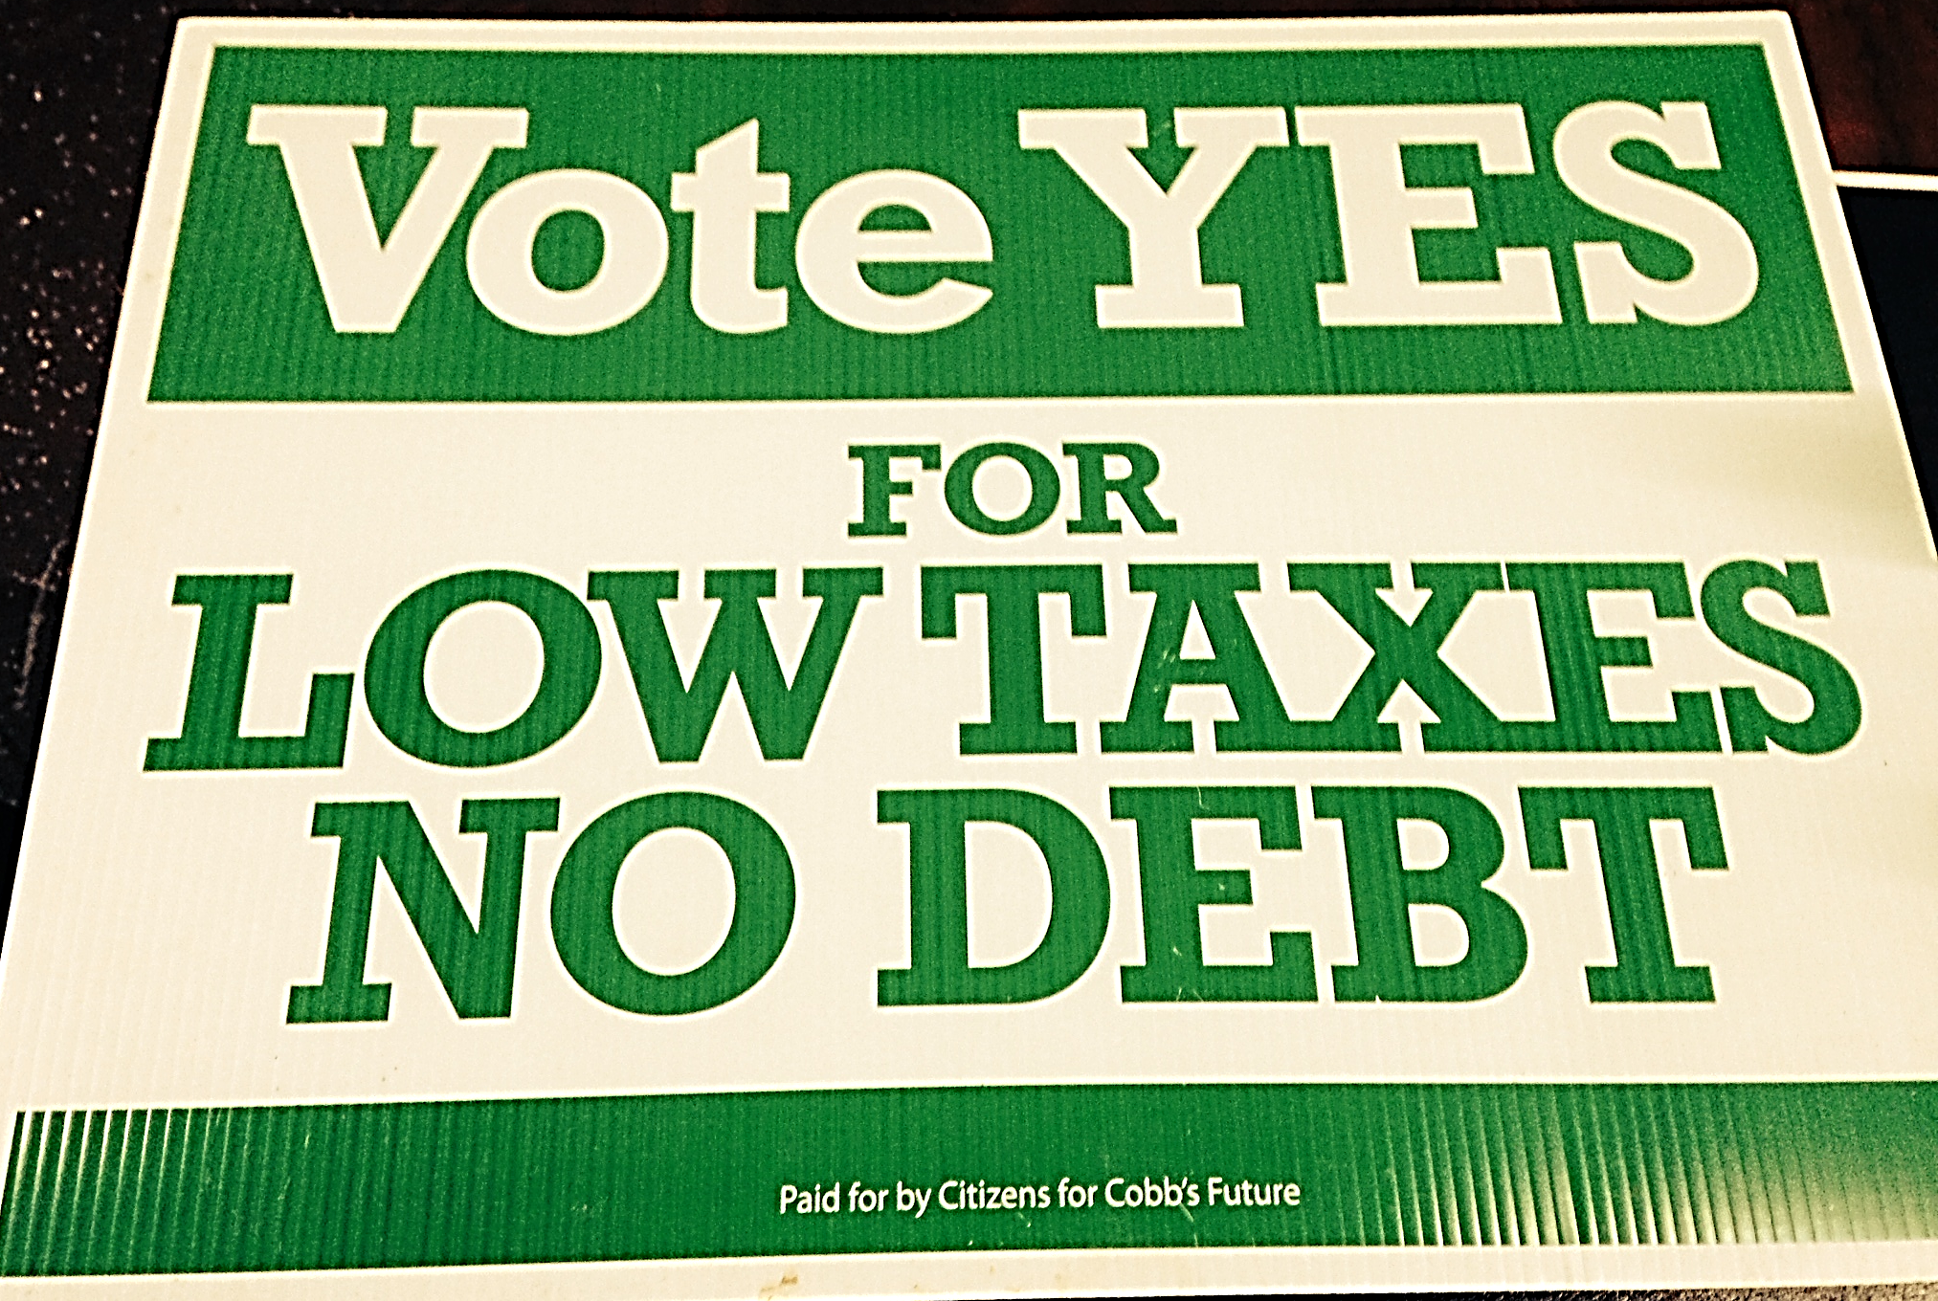
Can We Trust Our Elected Leaders?

Slide 18
Action Plan
Hold regular team meetings – Suggest bi-weekly
Lawn Signs – At least 1,500
Literature distribution – Half-page (Printing & How to Distribute)
Newspaper advertising, stickers on the MDJ, and direct mail.
Presentations & Debates – Civic clubs, League of Women Voters, Rotary, Lions Club, Kiwanis
Media – Radio, newspapers, online blogs, free interviews with local news channels
Coalition Building with other groups.
Website and Social Media
Robocalls
Events – Weekend Farmers Markets, concerts, games –
Hand out literature and inform the public

